Slide 1
From Practice to Perfection: AI Interview App
Hardik Dhingra (A010)
Janisa Kaur (A021)
Vidhika Rangwani (A023)
Shorya Mehra (A027)
Kesmyaa Nayyar (A028)
Mentor: Prof. Subhash

Slide 2
Problem Statement
Students and professionals often face challenges in preparing for interviews due to limited access opportunities, lack of objective feedback, and uncertainty about their performance.
Traditional preparation methods, such as self-practice or informal peer reviews, may not provide accurate assessments, leaving them unaware of their strengths and weaknesses.

Slide 3
Literature Review
Name | Authors | Year | Abstract
AI-enhanced interview simulation in the metaverse. | Abdullah Bin Nofal, Hassan Ali | 2025 | Proposes Interview Training Education Model (ITEM), which creates interview experiences for skill enhancement.
Fairness in AI-Driven Recruitment: Challenges, Methods, Metrics Nd Future Directions | Dana F. Mujtaba, Nihar R. Mahapatra | 2024 | Highlights the current challenges and future directions for developing fair AI recruitment applications, ensuring equitable candidate treatment, and enhancing organizational outcomes.
BERT: A Review of Applications in Natural Language Processing and Understanding | M.V. Koroteev | 2021 | The paper describes BERT's operation mechanism, the main areas of its application to text analytics, comparisons with similar models in each task, and a description of some proprietary models.

Slide 4
Objectives
Develop an AI-powered interviewer that accurately replicates real-world job interviews through dynamic, adaptive questioning. Support diverse formats, including behavioral, technical, and situational interviews, while incorporating industry-specific variations to ensure authentic practice scenarios.
Utilize NLP technology to objectively evaluate user responses based on clarity, relevance, and structure. Generate comprehensive scoring with actionable insights, enabling users to identify strengths and improvement areas through comparison with model responses
Provide personalized feedback to improve communication techniques, answer structuring, and question-handling abilities.

Slide 5
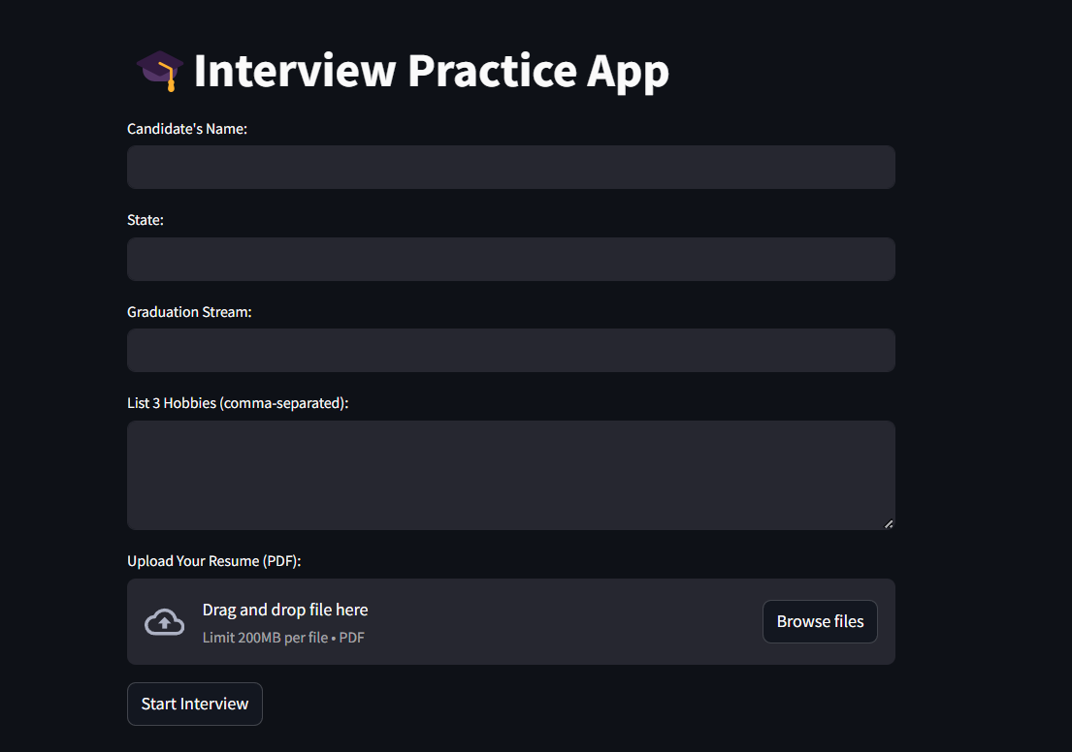

Slide 6
Google Gemini API
We have used Gemini 2.0 Flash, which processes the candidate’s resume to understand skills, hobbies and experiences to customize the interview questions
It ensures that the questions stay coherent and aligned with the candidate’s domain and background
For example, if the resume includes Python projects, the app prioritizes project-specific questions and learnings over generic topics.

Slide 7
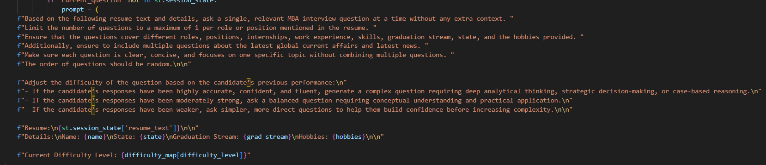
Prompt Engineering

Slide 8
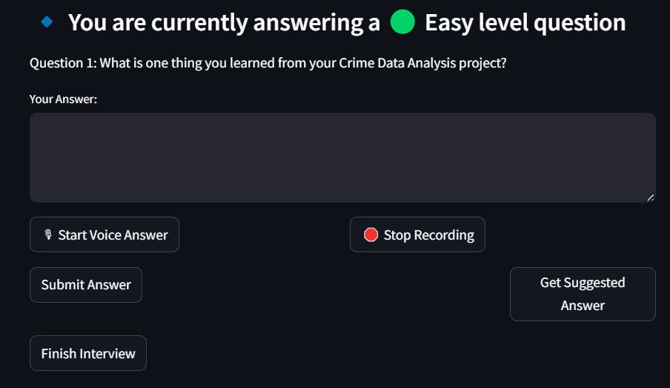

Slide 9
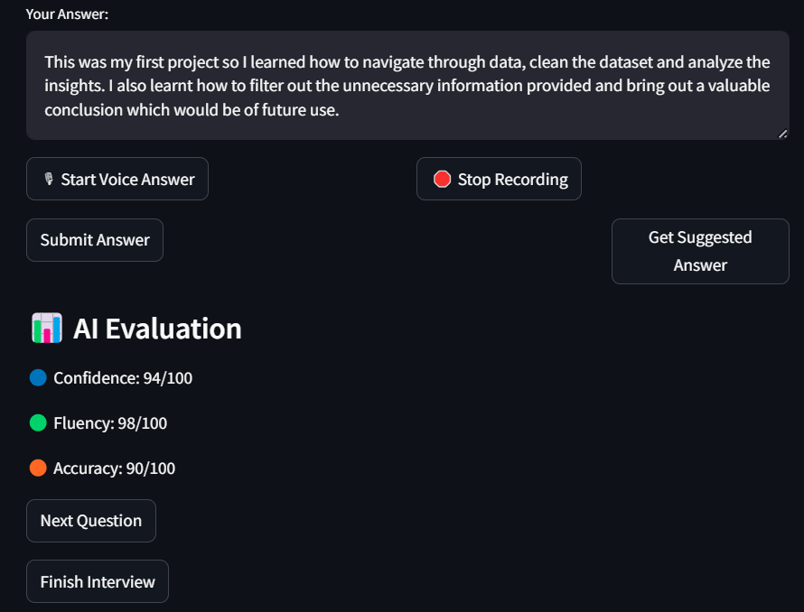

Slide 10
Textual Models
Ridge Regression
It is a type of traditional machine learning model used for text-based regression tasks. It converts text into numerical features and applies linear regression to it for the purpose of scoring responses or sentiment analysis.
BERT
(Bidirectional Encoder Representations from Transformers)
It is a deep learning transformer-based model used for powerful tasks like text classification, sentiment analysis, question answering and response scoring.

Slide 11
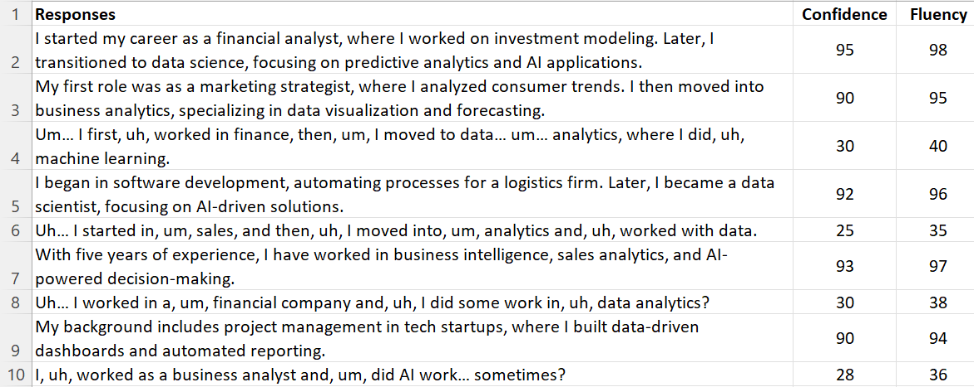
Snippet of the Data

Slide 12
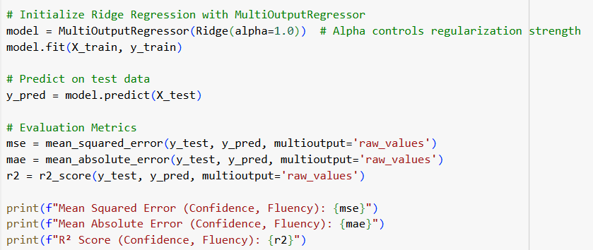
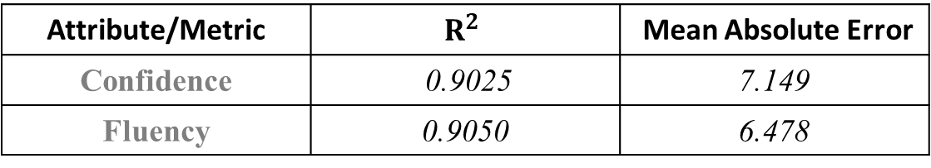
Evaluating Responses
Ridge Regression
Attribute/Metric | $$R^{2}$$ | Mean Absolute Error
Confidence | 0.9025 | 7.149
Fluency | 0.9050 | 6.478

Slide 13
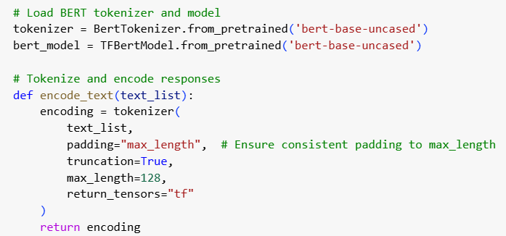
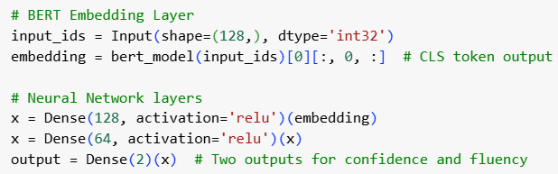
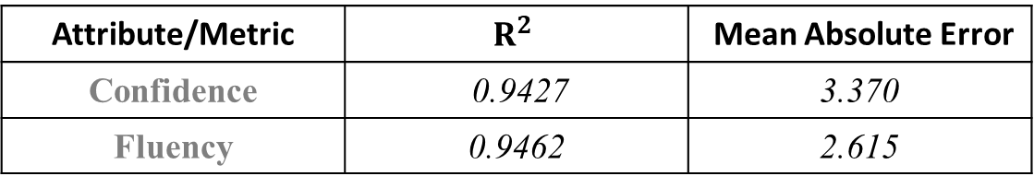
Evaluating Responses
BERT
Attribute/Metric | $$R^{2}$$ | Mean Absolute Error
Confidence | 0.9427 | 3.370
Fluency | 0.9462 | 2.615

Slide 14
Why BERT?
BERT processes words in context rather than in isolation, which makes it ideal for evaluating interview answers, where meaning depends on sentence structure and context.
BERT is useful for open-ended questions where multiple correct answers exist, as it assesses the semantic correctness of a response rather than checking for exact word matches.
It can assign scores based on grammar, coherence, technical accuracy, and completeness rather than relying on predefined keyword sets.
BERT’s ability to understand context, compare meaning effectively, and adapt to different responses makes it a great model for scoring answers in our Interview App.

Slide 16
Reinforcement Learning
Reinforcement Learning (RL) is a type of machine learning where an agent learns to make decisions by interacting with an environment to maximize cumulative rewards through trial and error. Unlike supervised learning (which relies on labeled data) or unsupervised learning (which finds patterns in data), RL is driven by feedback from actions in the form of rewards or penalties.

Slide 17
Reinforcement Learning
The app uses reinforcement learning to dynamically adjust the difficulty level of the questions based on the user’s responses.
This adaptive mechanism follows a Multi-Armed Bandit (MAB) approach, balancing exploration and exploitation to maximize engagement and challenge.
In this case, our app acts as the agent, deciding whether to present an easy, moderate, or difficult question based on the user’s previous response.
User answers a question
RL evaluates the scores
Adjusts next question’s difficulty

Slide 18
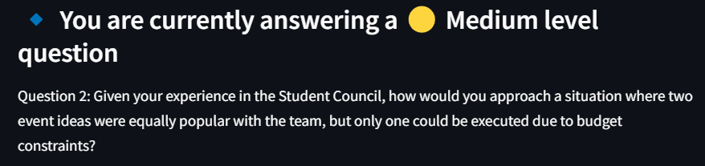
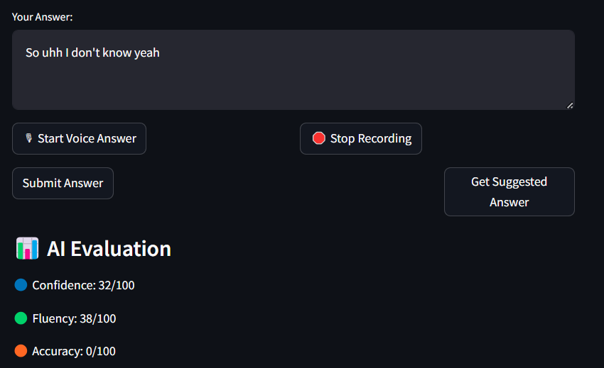

Slide 19
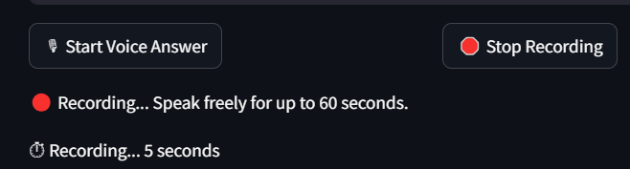
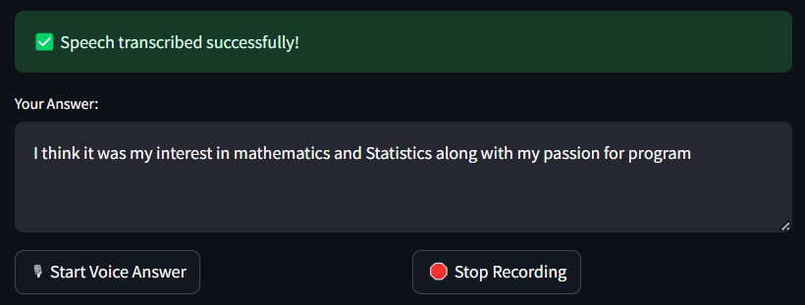
Application Features
Speech-to-Text Transcription

Slide 20
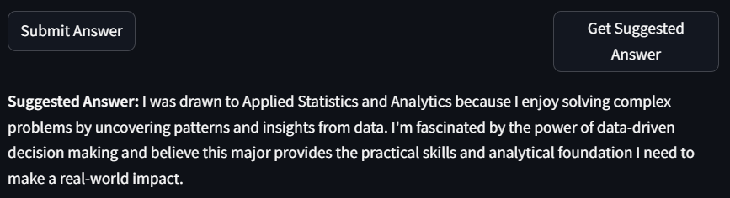
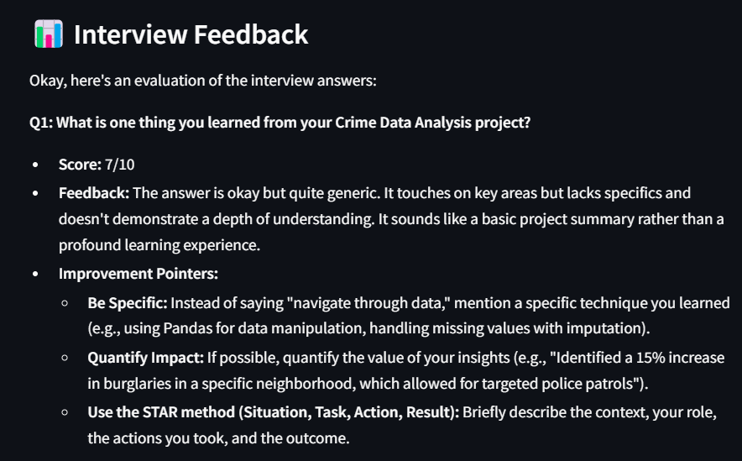
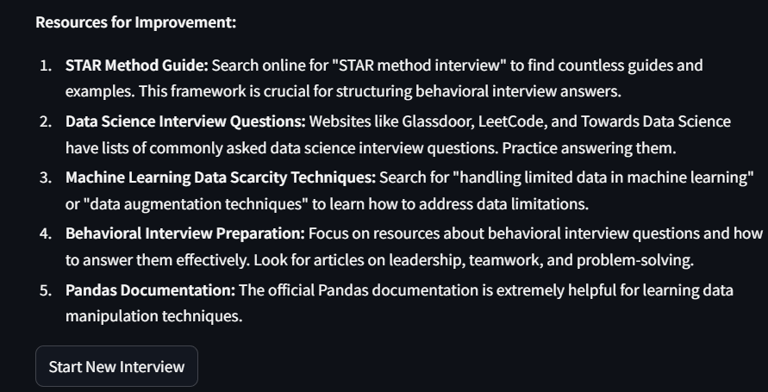
Application Features
Get Suggested Answers
Get feedback per answer
Resources for improvement

Slide 21
Conclusion
Our AI Interviewer app provides an intelligent and adaptive platform for students to practice interview questions, receive automated scoring, and gain detailed feedback.
By leveraging BERT for response evaluation and Reinforcement Learning for dynamic question difficulty adjustment, the app ensures a structured and personalized learning experience.
This helps individuals identify weaknesses, improve communication skills, and gain confidence for real-world interviews.

Slide 22
Limitations
Limited handling of non-verbal cues: The app currently evaluates only recorded or textual responses, meaning body language, facial expressions, and voice modulation are not considered.
Speech-to-text accuracy issues: Background noises, accents, or unclear pronunciation may lead to misinterpretations in transcription, affecting the scores.
Handling ambiguous or creative responses: BERT may struggle to accurately evaluate highly subjective or unconventional answers that require human judgment.

Slide 23
Future Scope
Multimodal Evaluation: Integrate facial recognition and voice analysis for holistic interview assessment.
Real-time Coaching and Feedback: Provide live hints or suggestions while the candidate is speaking.
Skill Progression Tracking: Allow users to track improvement over multiple practice sessions using dashboards and analytics.
Industry-Specific Training: Provide job-specific question banks tailored to different roles or industries.

Slide 24
THANK YOU!

